Slide 1
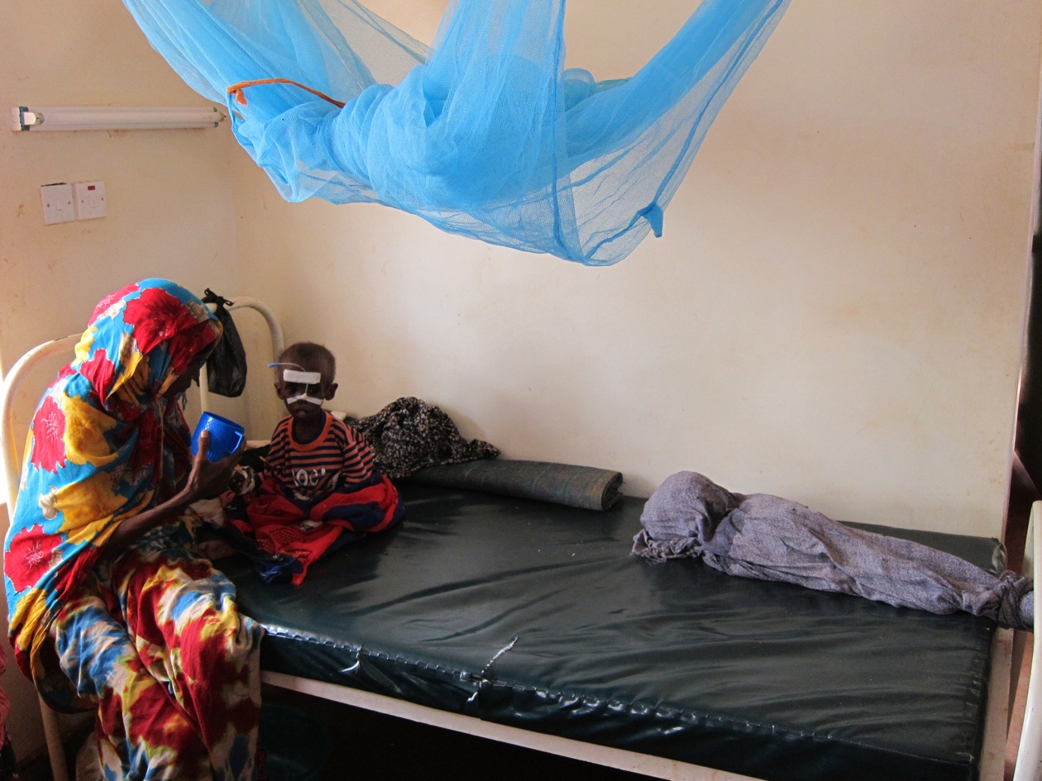

Slide 2
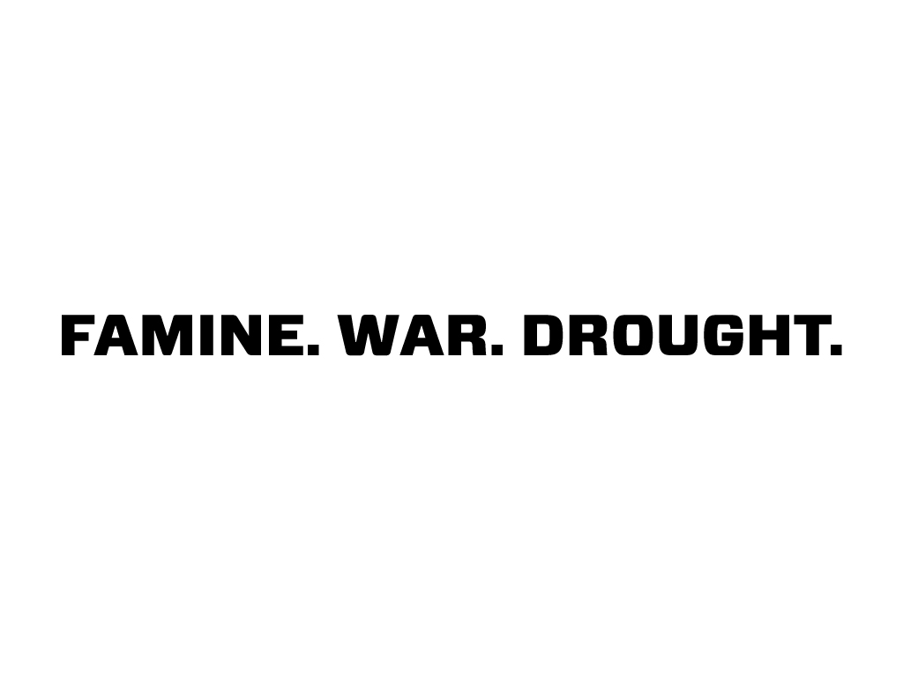

Slide 3


Slide 4


Slide 5
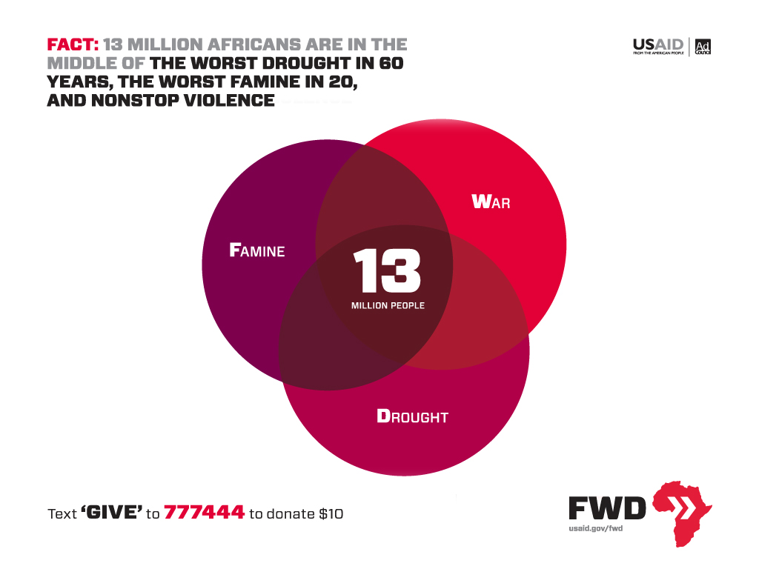
Notes:
13 million people are at the deadly intersection of famine, war, and drought. Famine: More than three in 10 children are acutely malnourished, More than two for every 10,000 people die in a day, One in five people are unable to access basic foods. Warfare (in Somalia): Twenty ungoverned years have left the Somali people facing a daily reality of insecurity and conflict. Humanitarian access is restricted or denied in the Somali areas where famine has been declared. Drought: Severe dry seasons result in withered crops and dead livestock. Droughts are cyclical and will continue to occur. Drought does not have to lead to famine.

Slide 6
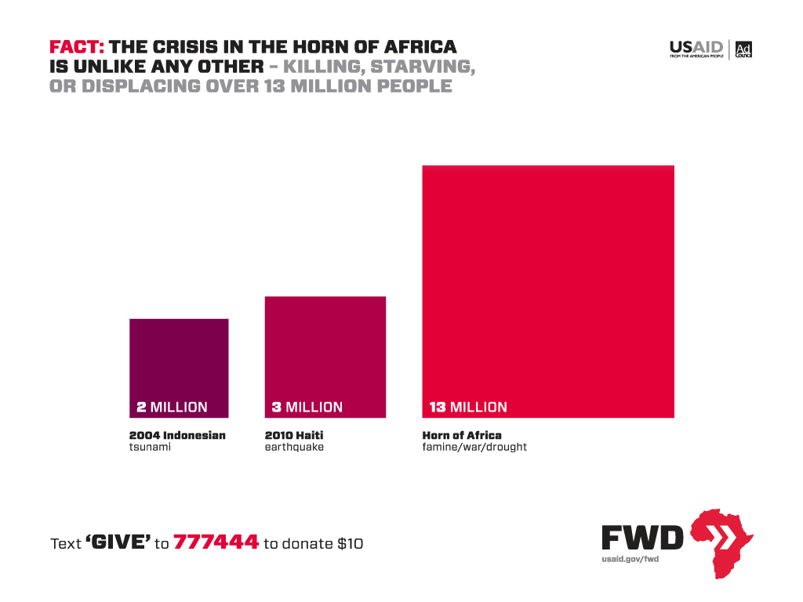
Notes:
The amount of people impacted by this crisis is much more than previous crisis that garnered much more attention. That is why USAID and Ad Council joined together to launch an awareness campaign for the crisis. The campaign- FWD- stands for famine, war, and drought.

Slide 7
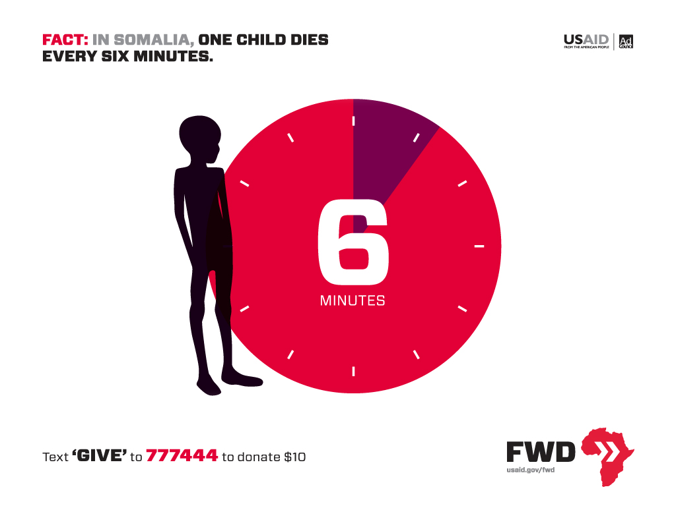

Slide 8
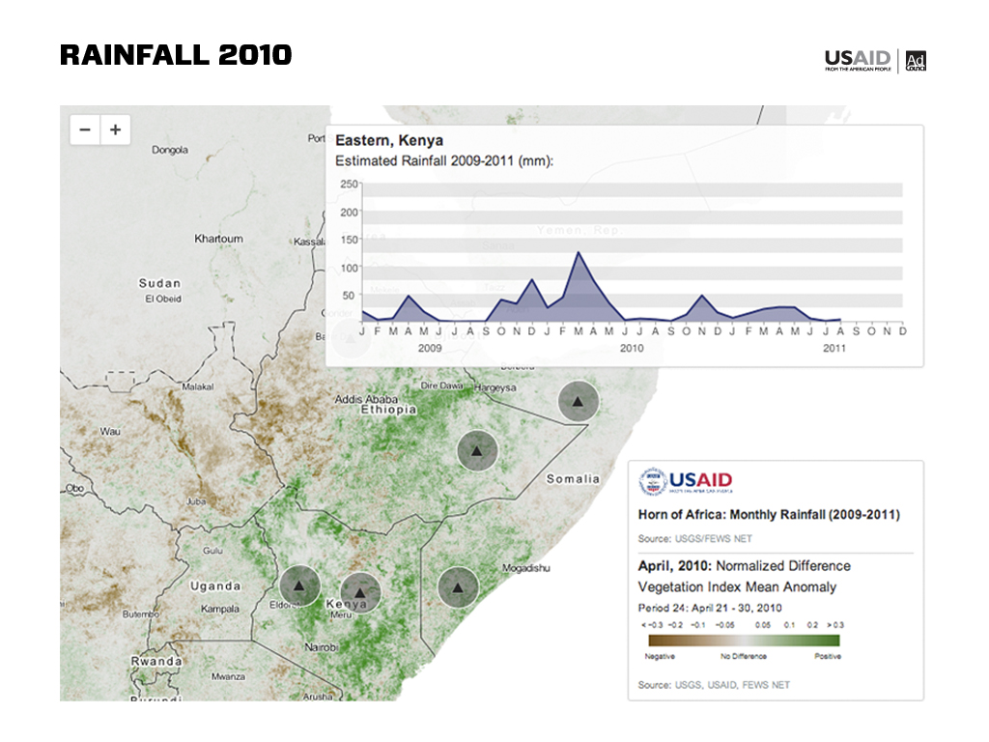

Slide 9
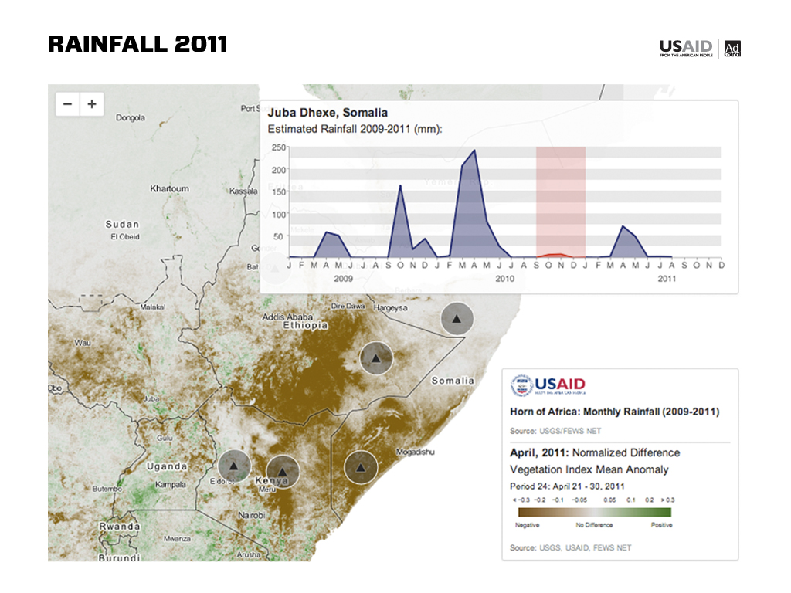

Slide 10
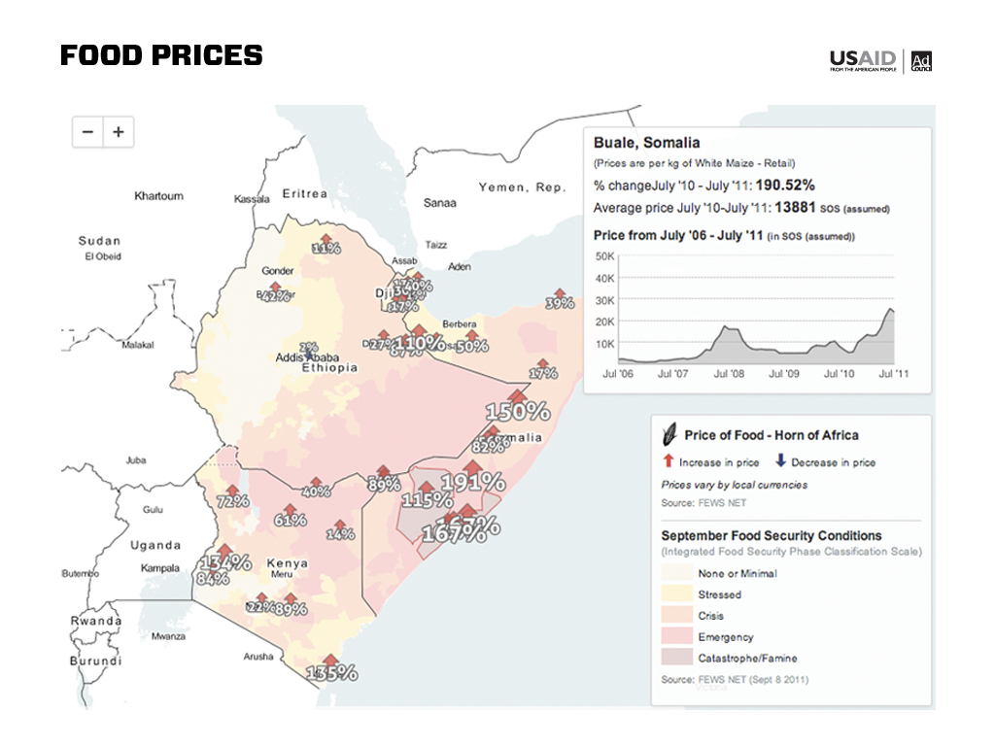
Notes:
Food Prices Soar. As food ran out and the land dried up, prices for traditional foods like maize, sorghum, and rice, soared. In some places prices increased as much as 300 percent. Livestock began to die off and communities struggled to feed their children.

Slide 11
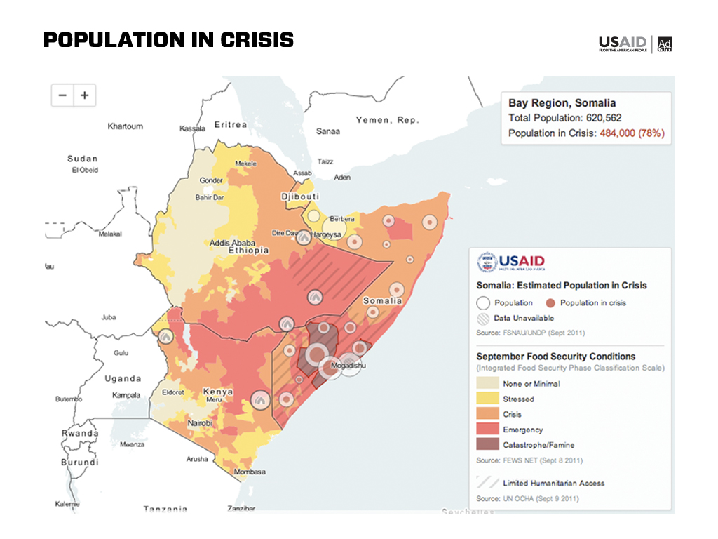
Notes:
Famine has been declared in parts of southern Somalia, in the regions that are most difficult for aid workers to reach with food and emergency supplies. Drought is affecting millions in neighboring countries and threatens to extend beyond those borders in coming months. Hunger and extreme drought are contributing to instability in an already delicate region, with potentially global effects.
The United Nations officially declared famine in Somalia on July 20, 2011. Famine is now prevalent in six areas of southern Somalia, which is controlled by violent militant groups that are blocking aid worker access and life-saving assistance.

Slide 12
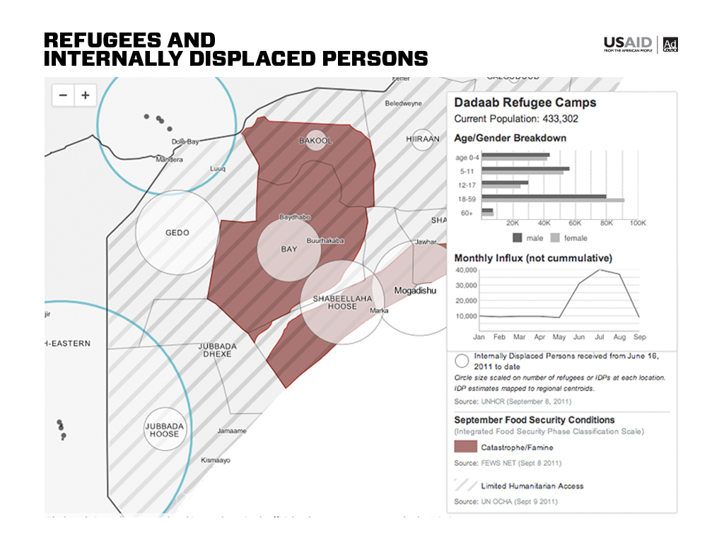
Notes:
With the drought unrelenting and food harder to find, families left their homes in search of vital food and medicine. Somalis living near Mogadishu fled to the urban hub and established impromptu camps. Refugees surged across borders and into to camps in Kenya and Ethiopia. In some cases families are walking more than 100 miles to find assistance

Slide 13


Slide 14
Get Involved
usaid.gov/FWD

Slide 15

FWD the Fact of the Day
FWD the site to your friends
Update your Profile Picture
Take the FWD Quiz
usaid.gov/FWD

Slide 16

Write an Op-ed or Letter to the Editor
Send an e-mail to your friends and family
Publish a blog post to raise awareness
Display the FWD badge on your site
usaid.gov/FWD

Slide 17

Host a House Party
Use our Program Insert
Use our Backgrounders
Share your stories about how you’re increasing awareness
Screen Videos and PSAs
usaid.gov/FWD
usaid.gov/FWD

